Slide 1

Presentation on
INTERNSHIP (PCA20P01L) by
Jatin Sharma
(RA2132241030008)
Department of Computer Applications
SRM Institute of Science & Technology
NCR Campus, Modinagar
Delhi-Meerut Road, Sikari Kalan, Modinagar–201204, GHAZIABAD (U.P.)

Slide 2
Company Name : Alldomainsoft.com Pvt.Ltd.
Location : 1032 Spaze iTech Park, SohnaRoad • Gurgaon
No of Branches : N/A
Investors : VED PARKASH YADAV, DEEPAK KUMAR YADAV
Services : Software Publishing
Presented by: Jatin Sharma (RA2132241030008) , Deptt. of Computer Applications

Slide 3
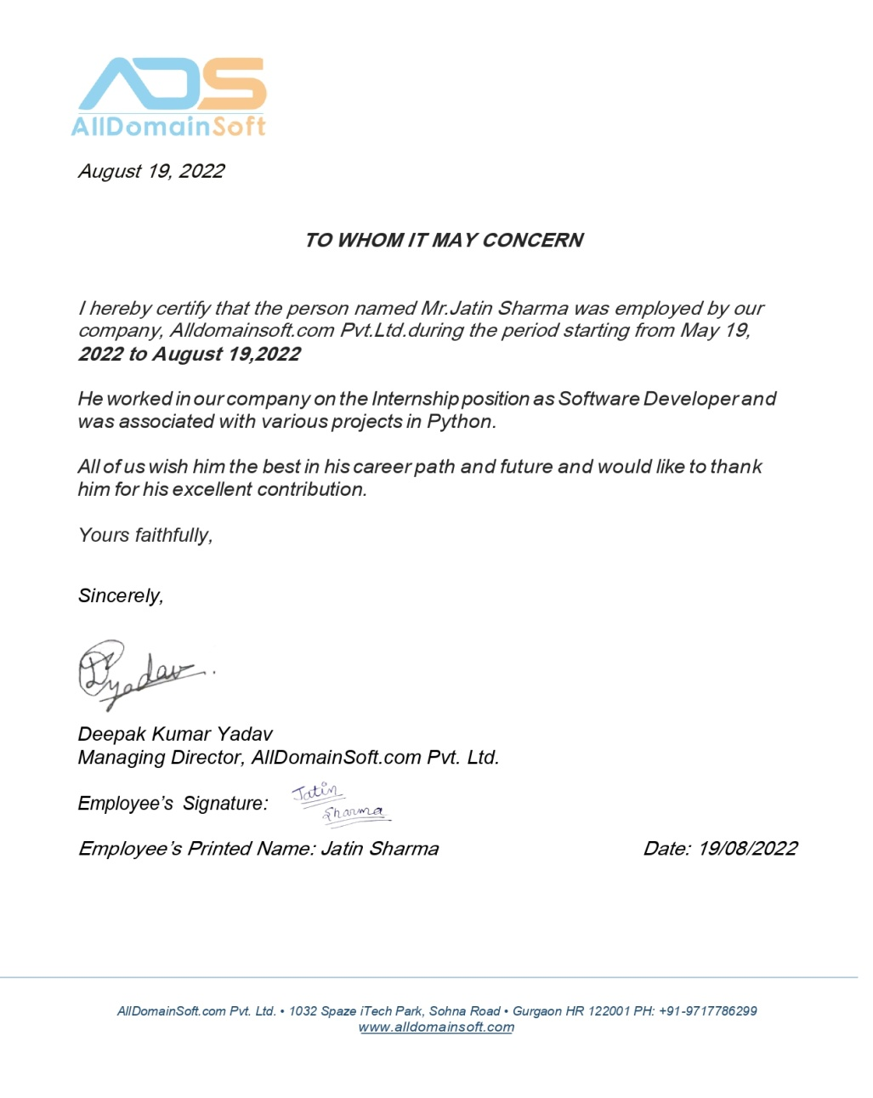
Certificate Received from Company :
Presented by: Jatin Sharma (RA2132241030008) , Deptt. of Computer Applications

Slide 4
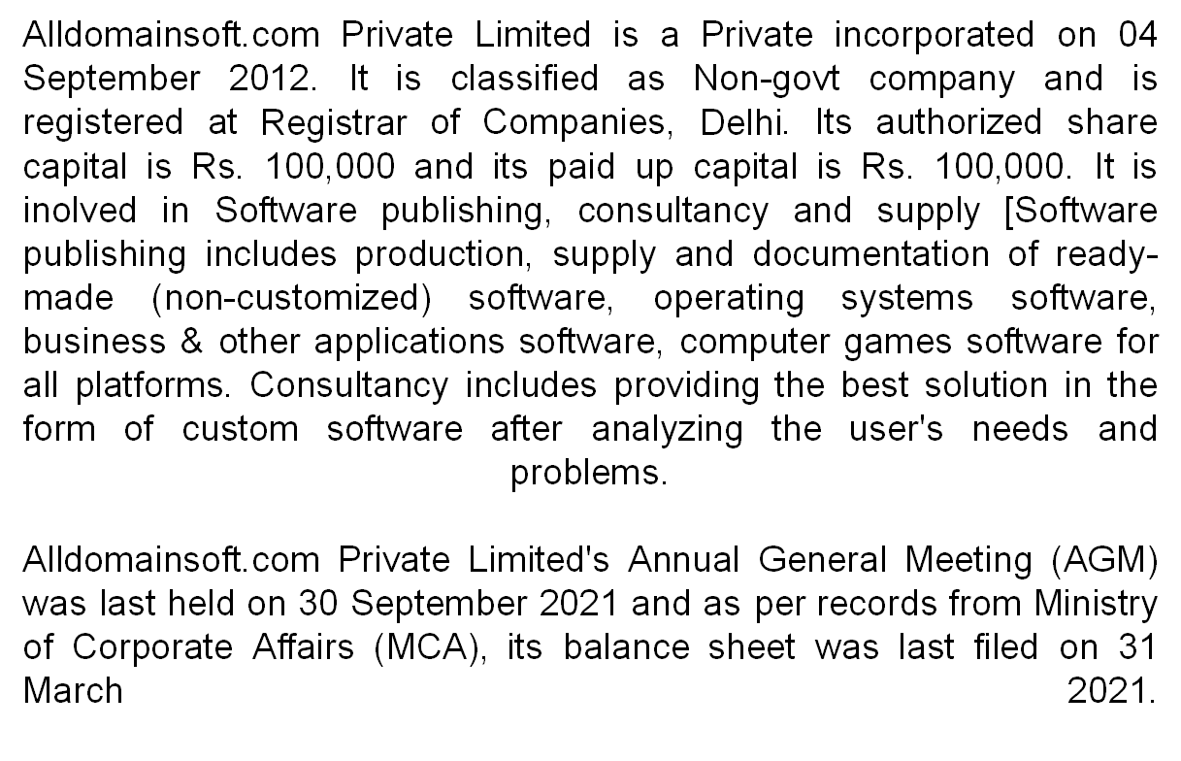
About Company :
Presented by: Rituraj Singh (RA12345678) , Deptt. of Computer Applications

Slide 5
Introduction to Project :
The scope of the project is to create a classmonk.com website. The reason behind to create a web based application easily customizable, accessible anywhere, accessible for a range devices, increased security etc.
The advance admin panel is created to monitor the users and handle all the admin related task. There is different role to different admin which are handled by the super admin. All the web API are created using Laravel and MYSQL is used as the required database. Few test cases are created and manual testing is used in this project.
Test cases are created in a manner to check all the required field level validations and also database validations. Once the application is created the corresponding test cases are executed against couple of runs and the bugs are resolved if any identified. Once the testing is done, the final product is delivered.
Presented by: Rituraj Singh (RA12345678) , Deptt. of Computer Applications

Slide 6
Task Assigned :
During the internship period knowledge of various platforms and programming languages are gained. The target was to deliver a fully-fledged web based system by using different tools and frameworks such as PHP (Laravel) and JS (Angular).
Hence, to meet that objective, this internship required the extensive preliminary studies about the core PHP before actually analyzing the actual requirement of the system. The study was required not only to understand the subject under study but also to realize the solutions to the existing problems and implementing the findings from the study was another bigger challenge. Besides study of, Core PHP other major activities carried out during internship was extensive study of current online platform, presentations of study analysis and practical implementations, and most importantly the team discussions to analyze the customer change request. The regular meetings with the Supervisor and discussion with mentors helped me to wide my horizon of knowledge of the existing system and problem background.
Software development is the collective processes involved in creating software programs, embodying all the stages throughout the systems development life cycle (SDLC). During my internship, Author worked on Classmonk project which was based on PHP (Laravel) and JavaScript (Angular) frame work.
Presented by: Jatin Sharma (RA2132241030008) , Deptt. of Computer Applications

Slide 7
Tools & Technologies Used :
When author has been told to work on Classmonk, author asked Deepak sir which technologies author need to learn to work this project. He gave me a list of technologies and author learned them.
SQL Query
Angular ( Front end JavaScript framework)
Web Socket
PHP (Laravel framework)
Presented by: Jatin Sharma (RA2132241030008) , Deptt. of Computer Applications

Slide 8
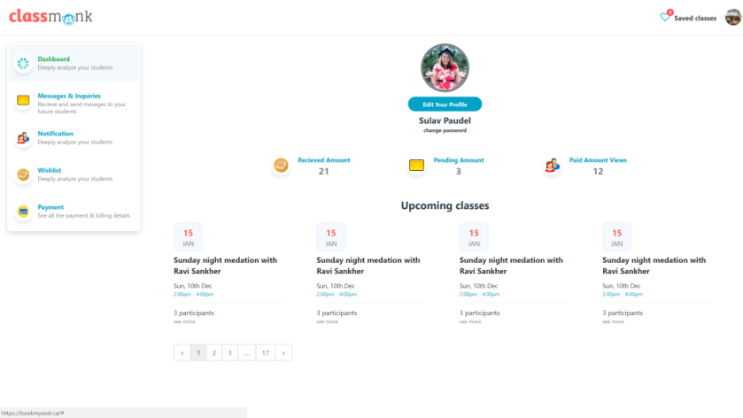
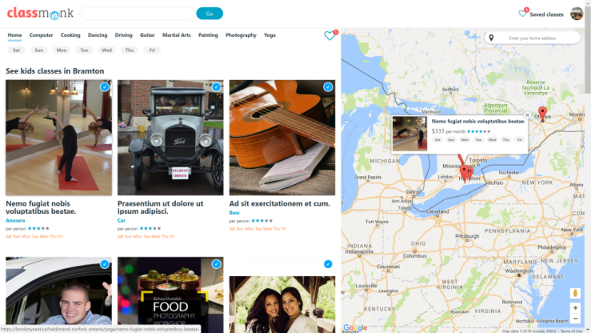
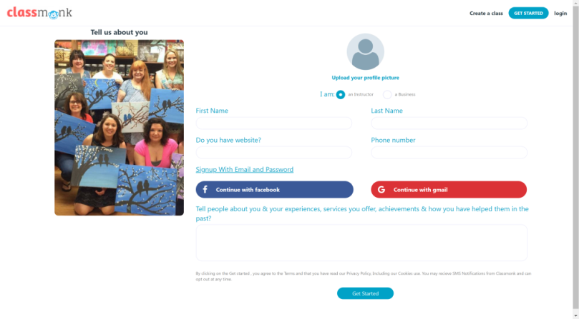
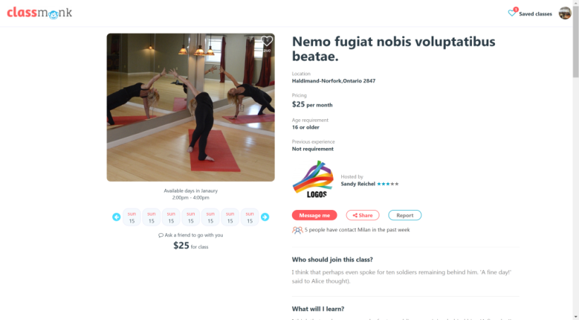
Results/Findings (in the form of screenshots) :
Presented by: Jatin Sharma (RA2132241030008) , Deptt. of Computer Applications

Slide 9
Thank You..!

